Slide 1
Cost Estimation for Electric Vehicles Charging Stations
Capstone Project - 2 (CP303)

Slide 2
Submitted By:- Yash Jain - 2019EEB1208 Swapnil Saurav - 2019EEB1204 Aishwarya Pal - 2019EEB1136 (Department of Electrical Engineering)
Project Supervisor:- Dr K. Ramachandra Sekhar Assistant Professor Department of Electrical Engineering Indian Institute of Technology, Ropar | Course Coordinator:- Dr Devarshi Das Assistant Professor Department of Electrical Engineering Indian Institute of Technology, Ropar

Slide 3
PROBLEM STATEMENT
Electric Vehicles are a promising technology in the coming times due to their pollution-free nature. Every electric vehicle needs to be charged. The charging cost of these EVs is calculated at the time of charging. Currently, there is yet to be a method which can determine/estimate the cost of charging an electric vehicle beforehand. Our team has decided to work on that part.

Slide 4
OUR APPROACH
The first thing we need to estimate is the power output of the solar panels. This further depends on the irradiance and temperature of the area. There is currently no API which gives the current irradiance data. Our first step now was to estimate the irradiance using the weather data. For that, we need to use Machine Learning. The data was taken from openweathermap.com and some private institutes. We have also utilized PV arrays in MATLAB to get power output data.
After that, we need to use that power output to predict the cost of charging.

Slide 5
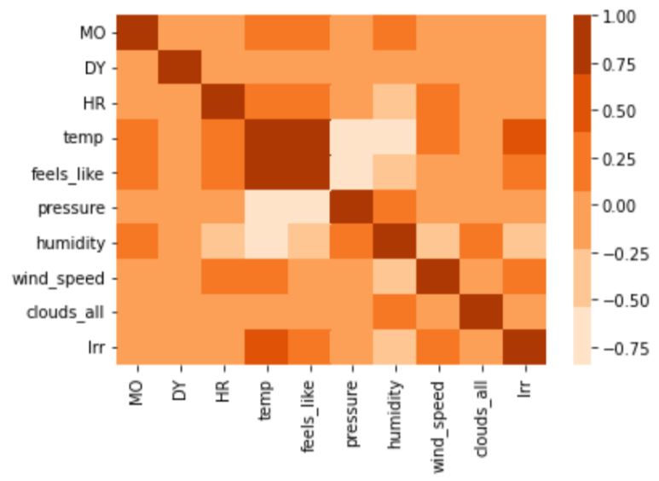
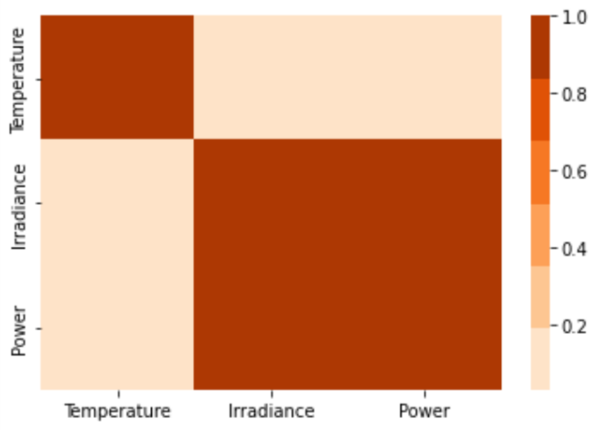
CORRELATION

Slide 6
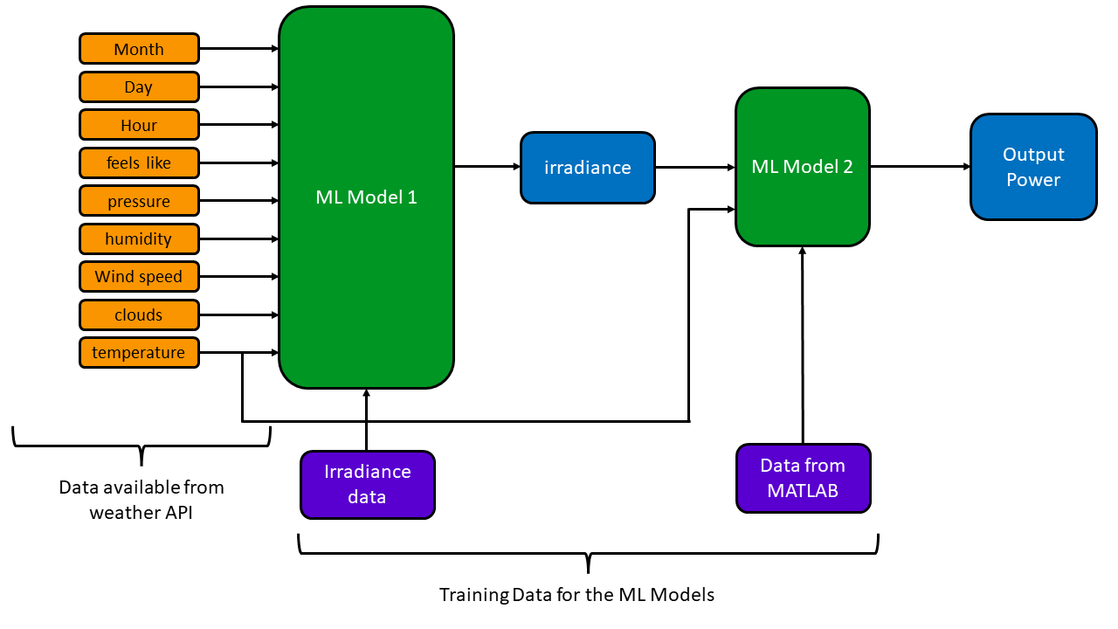

Slide 7
DATA
Weather Data taken from openweather API - Hourly Data for 5 years.
Irradiance Data taken from Ropar.
Power output data taken from MATLAB.

Slide 8
TECH STACK
Programming languages | Python, Matlab
Framework, Libraries | Tensorflow.js, NLTK, Scikit-Learn, Simulink, Keras, pandas, Matplotlib, Django, joblib (for saving model)
Tools | Google Colab, Google Sheets

Slide 9
EXTRA TREES REGRESSOR
The extra trees algorithm, like the random forests algorithm, creates many decision trees, but the sampling for each tree is random, without replacement. This creates a dataset for each tree with unique samples. A specific number of features, from the total set of features, are also selected randomly for each tree. The most important and unique characteristic of extra trees is the random selection of a splitting value for a feature. Instead of calculating a locally optimal value using Gini or entropy to split the data, the algorithm randomly selects a split value. This makes the trees diversified and uncorrelated.

Slide 10
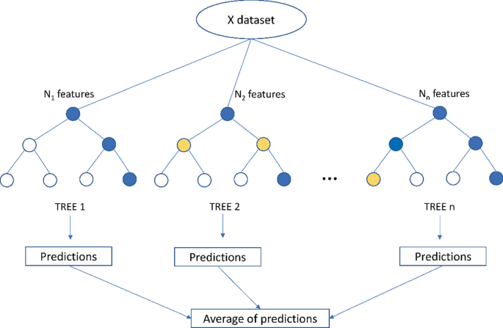

Slide 11
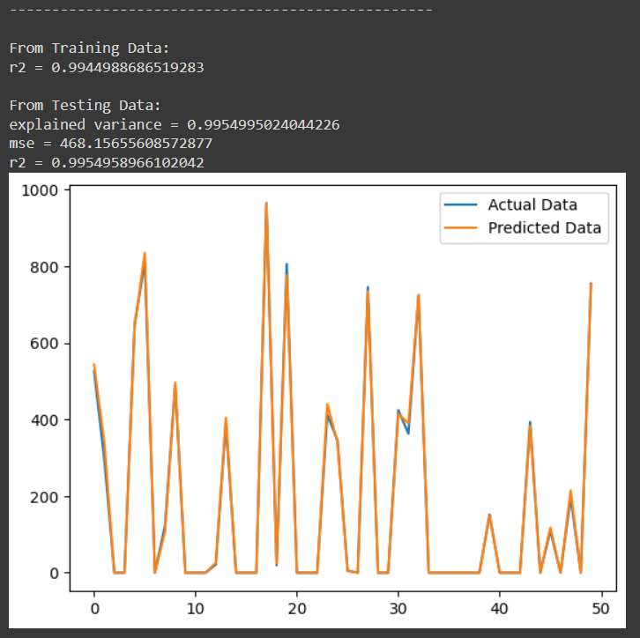
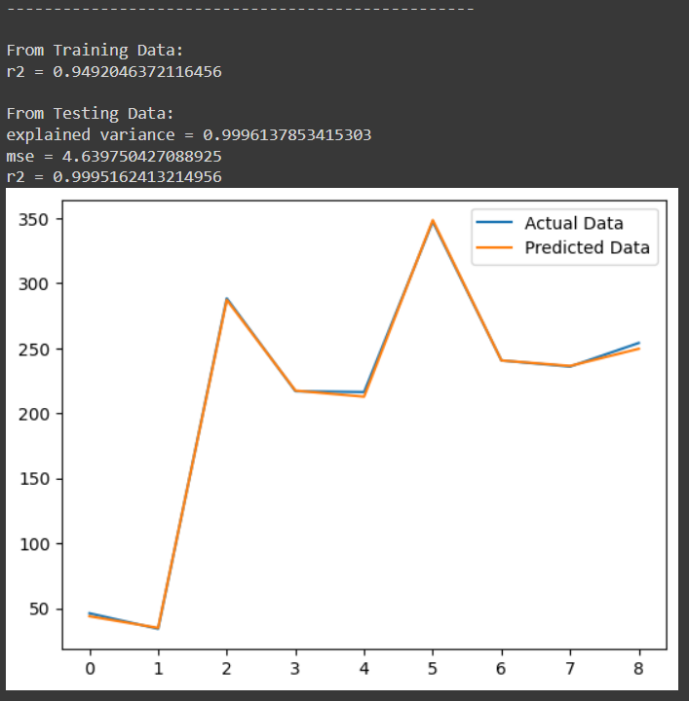
ACCURACY
Irradiance
Power

Slide 12
How the cost is calculated
There are two methods for charging: 1. Solar energy 2. Grid energy
Suppose we have to charge 30% of battery:
Multiple values of time for solar charging are taken.
Initially, 0 mins of solar charging => complete 30% is charged by grid
Now, solar charging time is 15 mins => rest is charged by grid
And so on…
We have the rate for solar charging and grid charging. Hence the cost is: t_solar * rate_solar + t_grid * rate_grid
The variation of t_solar vs cost is plotted and minimum point is obtained.

Slide 13
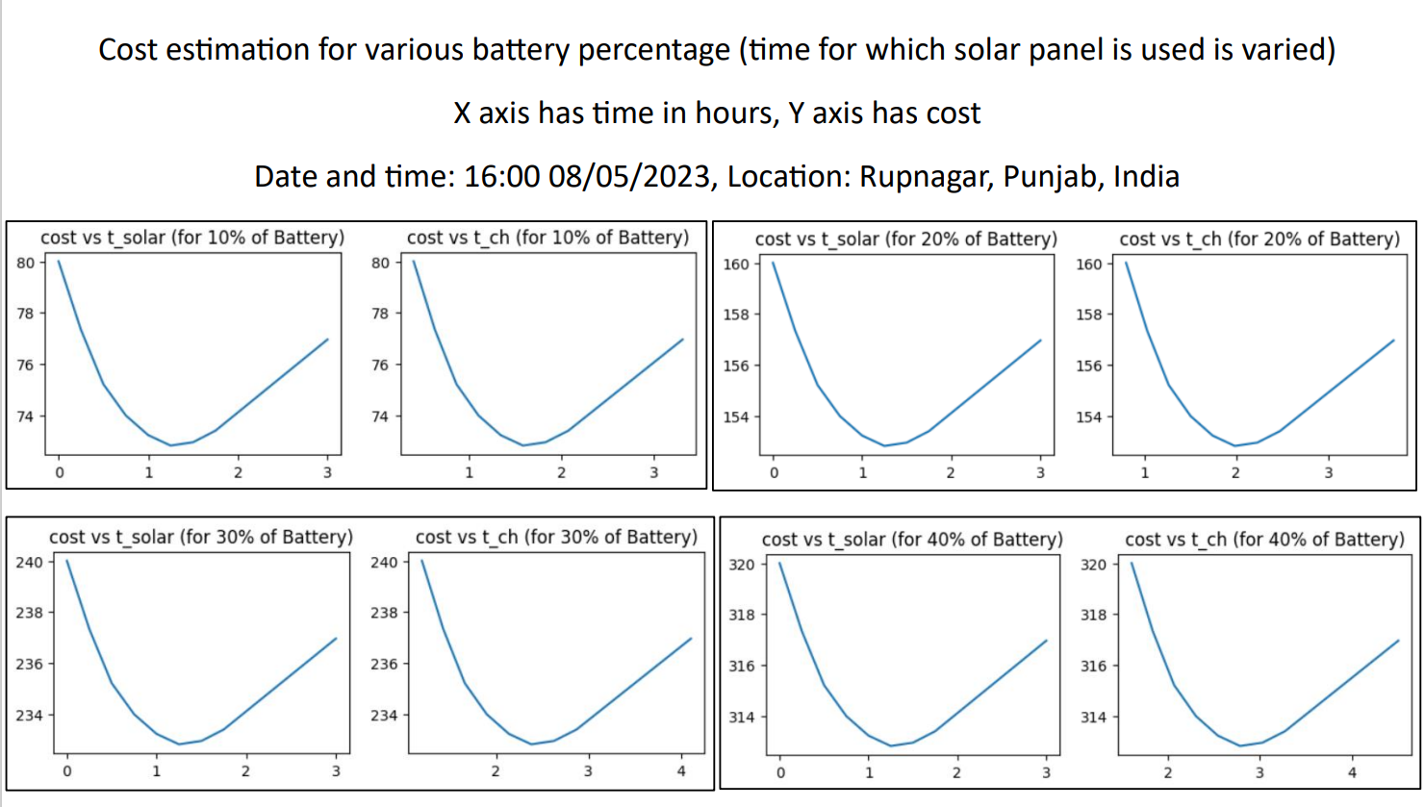

Slide 14

Mathematical Interpretation of Factors Contributing to the Cost Calculation
1. Rush Factor:
alpha is the rush factor which determines the traffic at the station.
The solar cost is now increased and the overall cost is recalculated. The graph is changed as shown:-

Slide 15
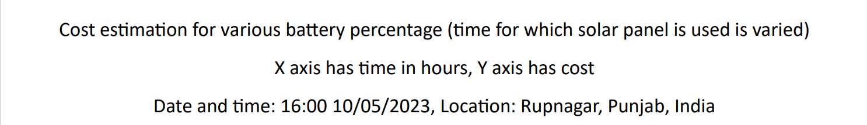
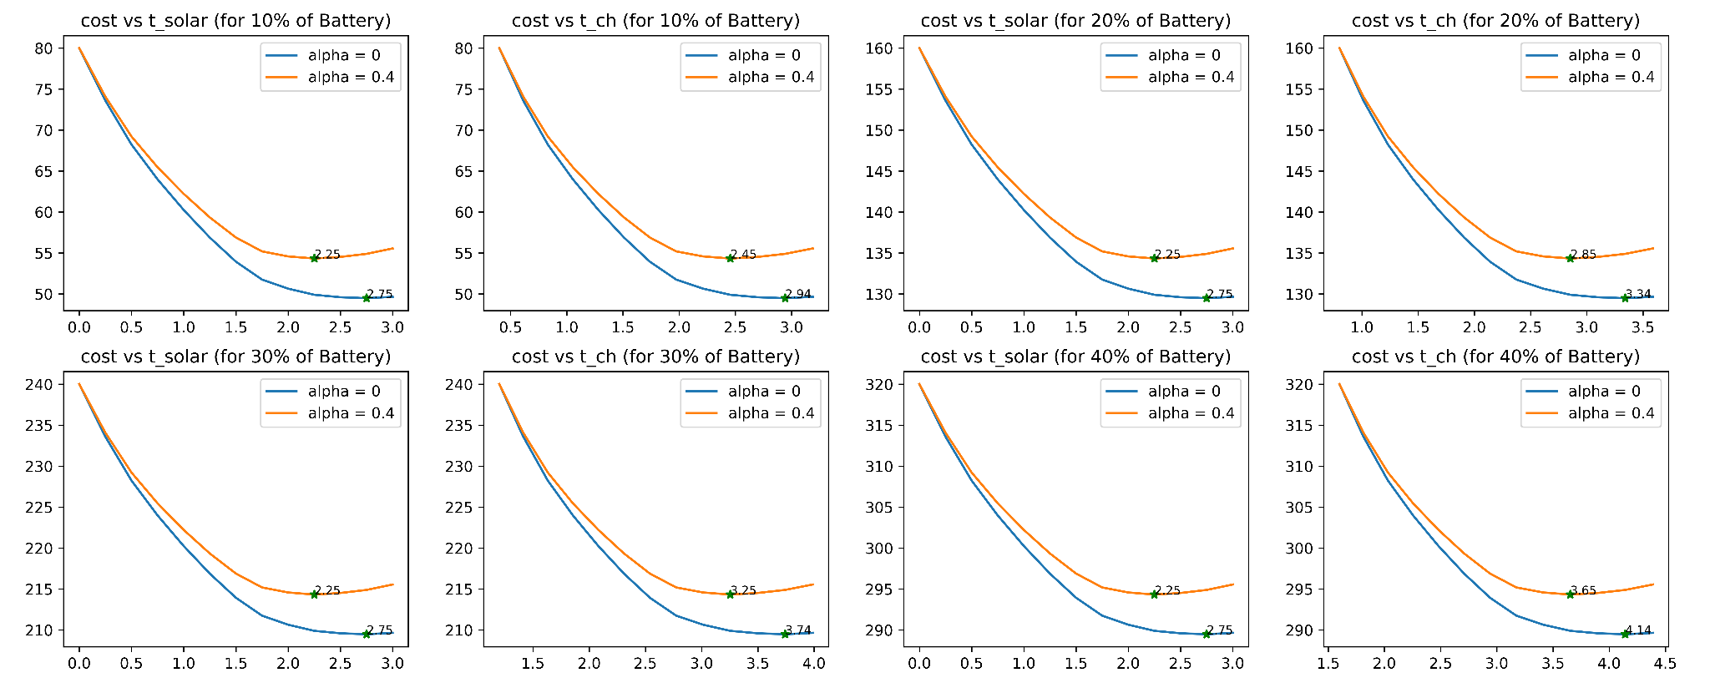

Slide 16
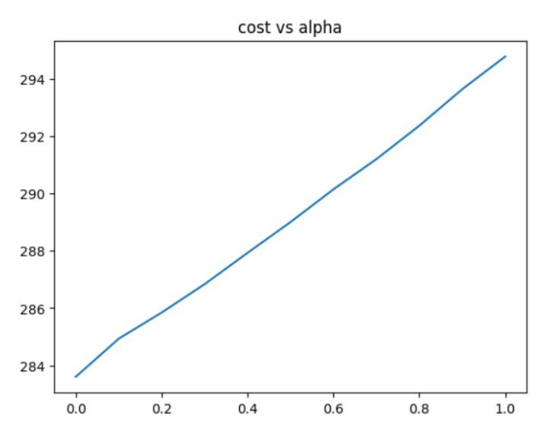
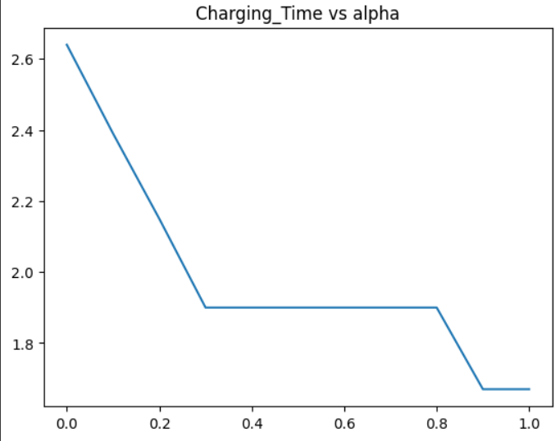
Variation wrt alpha

Slide 17
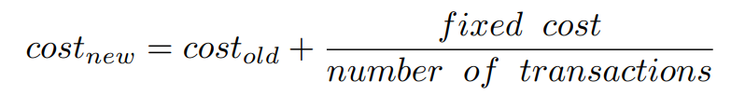
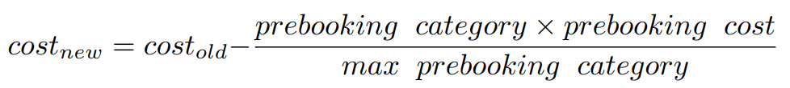

2. Fixed Cost Factor:
3. Pre-booking Factor:
4. Priority Factor:
5. Profit Factor:

Slide 18
Result
Sucessfully fetched the data from the API.
Month: 5.0
Day: 10.0
hour: 13.0
Temperature: 309.34
Feels_Like: 306.55
Pressure: 1005.0
Humidity: 10.0
Wind Speed: 4.17
Clouds: 0.0
alpha = 0.4, prebooking_category = 2, priority_rating = 2
base cost = 225.82050800000002, solar charging time = 3.0, total_charging_time = 4.06910254
cost after rush factor = 229.74940813348886, solar charging time = 1.75, total charging time = 2.84653317625
cost after fixed cost factor = 249.74940813348886
cost after prebooking factor = 229.74940813348886
cost after priority factor = 261.7494081334888
cost after profit factor = 287.9243489468377
FINAL COST = 287.9243489468377, SOLAR CHARGING TIME = 1.75, TOTAL CHARGING TIME = 2.84653317625

Slide 19
Future Scope
Our current machine learning model for predicting the irradiance is trained on the data for a single region, thus it may have errors for predicting the irradiance for some other region.
This error can be diminished by training the model with two new features (longitude and latitude of the region).
Also if we have the traffic data for charging station, we can automate the prediction of alpha (rush factor) according to the traffic.
We can also show the user different price of charging according to the time specified by the user in the application environment.

Slide 20
Code Flow
Extract current Weather Data from the Weather API.
Calculate Irradiance using Model 1.
Calculate Output Power using Model 2.
Vary the solar charging time from 0 to 3 hours (15 mins step) and obtain all the costs.
Use the min cost point as the operating point.
Apply all the factors as mentioned previously.
Generate the final cost.

Slide 21

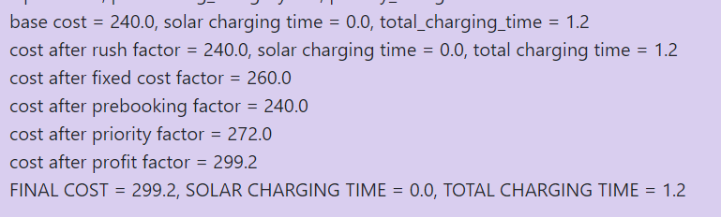
Webpage

Slide 22
THANK YOU

